Slide 1
History of Resource Use

Slide 2
Resource Myths
The Myth of Superabundance came from the idea that our natural resources were so abundant that it didn't matter how we treated them. (think Natural Capital)
We believe(d) mistakenly, that we would never run out of resources.
This has been supplanted by what we might call the Myth of Scientific Supremacy.

Slide 3
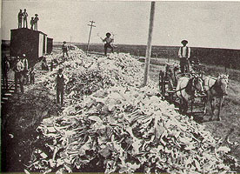
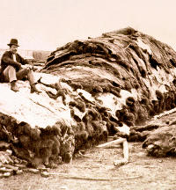
Myth of Superabundance
Overhunting of the American Bison

Slide 4

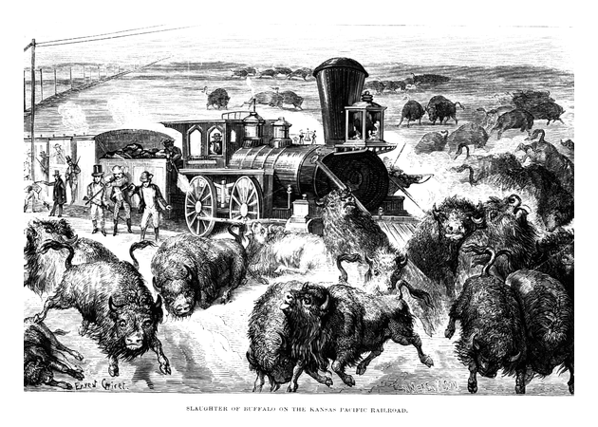
Differences in Attitude toward Nature (ie Resources)
Myth of Superabundance
Notes:
Frontier Environmental Worldview
-Man against Nature
-Nature was put here for Man
-Ownership issues
-Nature must be tamed

Slide 5

Bison
Range
1500
1850
1870
1880
1906

Slide 6
Myth of Scientific Supremacy
We will continue to trust that biotechnology, space science, or some yet undiscovered theory or invention will provide the answers to any environmental crisis.
i.e. the problems of technology will be solved by more technology
What are your initial thoughts on this?

Slide 7
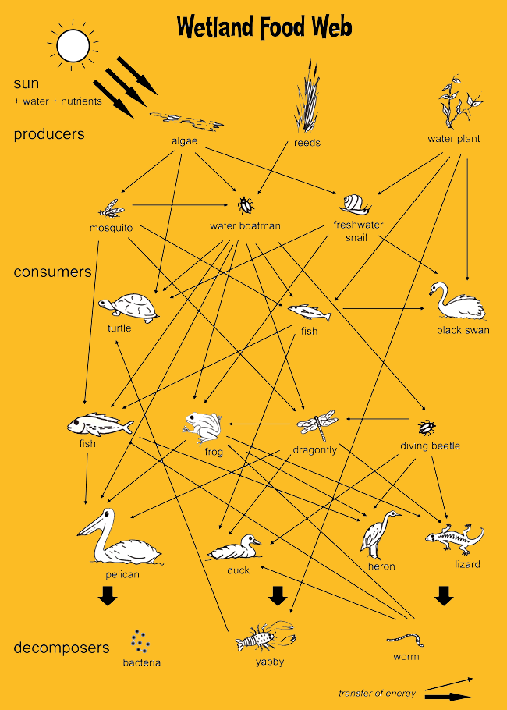
Problem:
Nature is not only more complex than we know…
it is probably much more complex than we can know.
Notes:
Just an example is this wetland food web --- Look at all the arrows on here! The food web has so many interdependencies and complex linkages – and this is just the food web, try factoring in the effect of pollutants, climate change, and other environmental changes on this web and try to predict the ripple effect it will have as some species decline and others thrive under new conditions

Slide 8
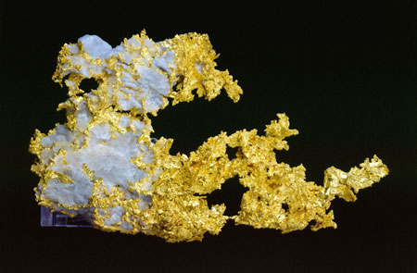
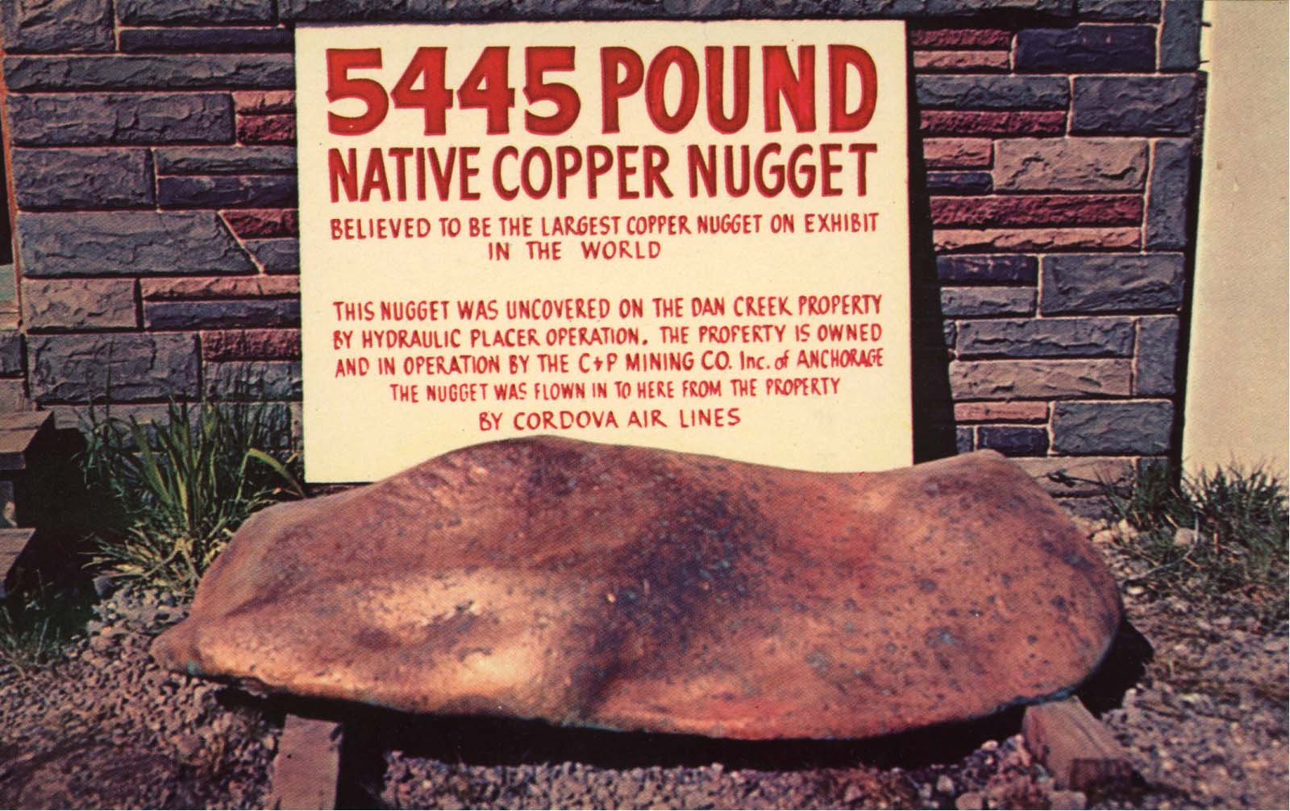
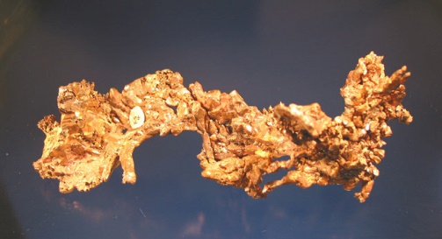
Humans and Metals – relationship history
Stone Age – first use of Minerals (as rocks)
Native metals (crystals of pure metal) were used first because it is easily mined and separated (no refining!)
Native gold (with quartz)
Native Copper

Slide 9
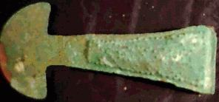
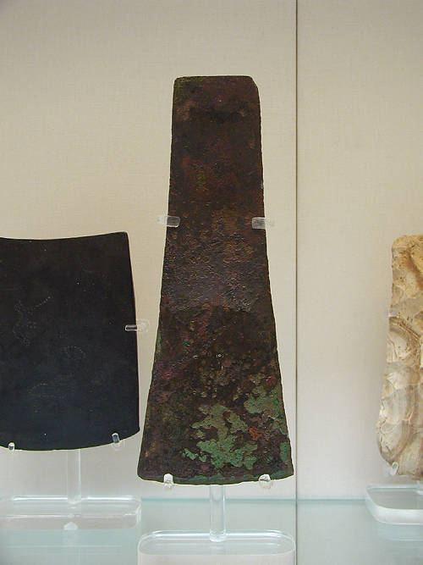
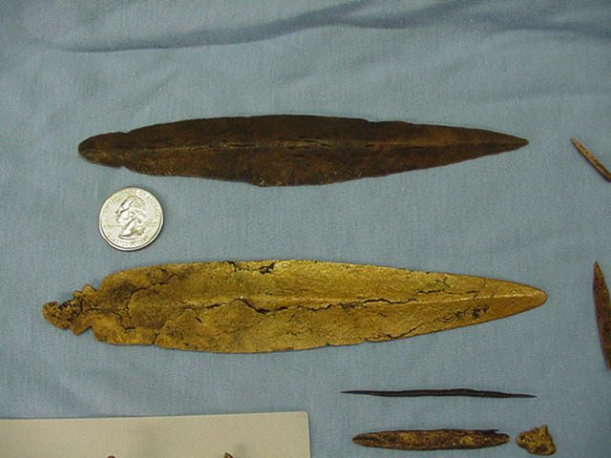

Early Availability of Native Metals
Copper is the most widely distributed native metal
It is harder and stronger than other native metals (e.g. gold and silver)
Advantage of copper tools apparent to early humans – used in Neolithic times
Copper Adze
Copper weapons

Slide 10
Copper Smelting – The Copper Age
Although native copper is hard to come by in large amounts, copper ores are quite common and some of them produce metal easily when burned in wood or charcoal fires.
People started smelting copper 6000 yrs ago in Egypt (~4000 BC).
Copper smelting started the Copper Age, lasting ~500 years

Slide 11
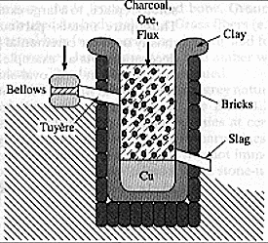
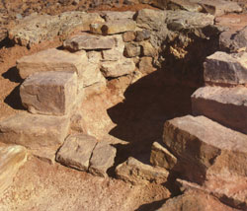
Early Copper Smelters

Slide 12
The shift to Bronze – The Bronze Age
Bronze is copper alloyed with tin (or sometimes with other metals e.g. silver, lead, or arsenic)
A problem: In parts of the world where copper ores were plentiful, tin was rare.

Slide 13
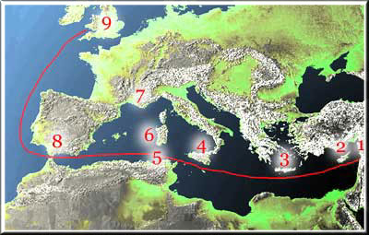
The shift to Bronze –Bronze and Tin
The only known large deposits of tin in the ancient world were in western Great Britain
Establishment of tin trade routes led to the Bronze Age
Early Trade Routes for Tin
First large-scale “international” trade
Notes:
Long trade routes for tin began by crossing the English Channel to Gaul (France) and continuing overland to Mediterranean ports and onto sailing freighters.
Such travel contributed to the high cost of tin, and therefore of bronze.
When the Romans near the end of the republic occupied Britain, an occupation that lasted for about 400 years, their main goal was probably control of the tin trade.

Slide 14
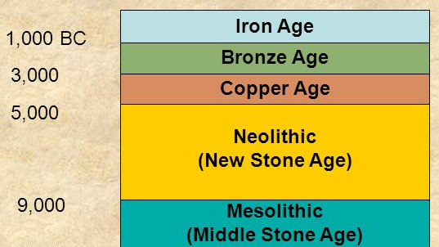
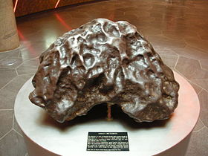
Bronze Age into Iron Age
Bronze Age ended ~800 BC.
Iron began to be worked around 1300 BC.
The first iron to be worked came from meteorites.

Slide 15
Working Iron requires more energy
The first iron could not be smelted easily, like copper, just heated enough to be reworked into useful items.
Since iron has a higher melting temperature than Copper, it must be smelted in a very hot fire and this required charcoal.
Blast furnace (1340 A.D.) = major breakthrough
large amounts of iron could be produced.

Slide 16
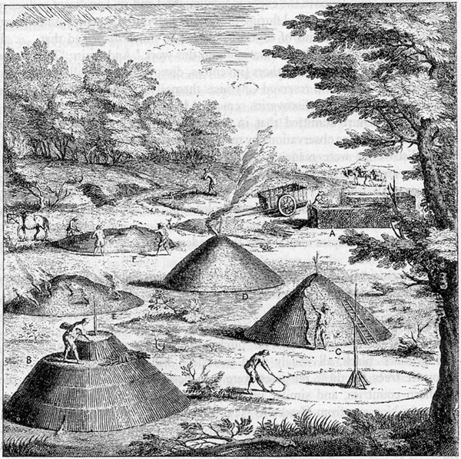
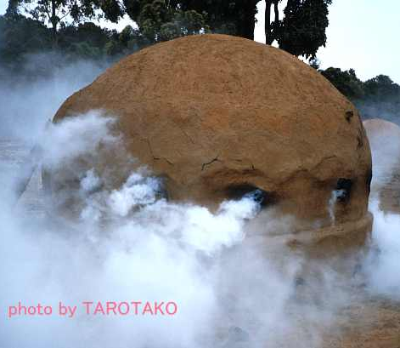
Making Charcoal
Cooking wood in a low oxygen environment
Process burns off volatiles such as water, methane, hydrogen, and tar.
Notes:
cooking wood in a low oxygen environment, a process that can take days and burns off volatile compounds such as water, methane, hydrogen, and tar.

Slide 17
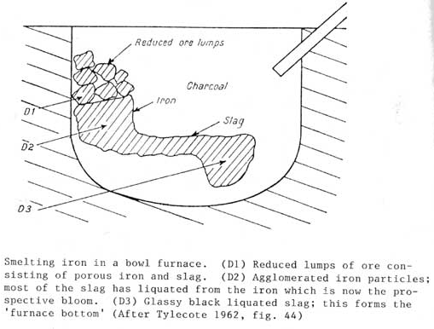
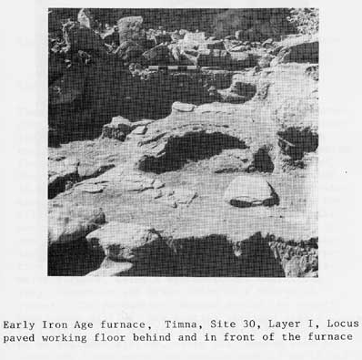
Early Blast Furnace

Slide 18
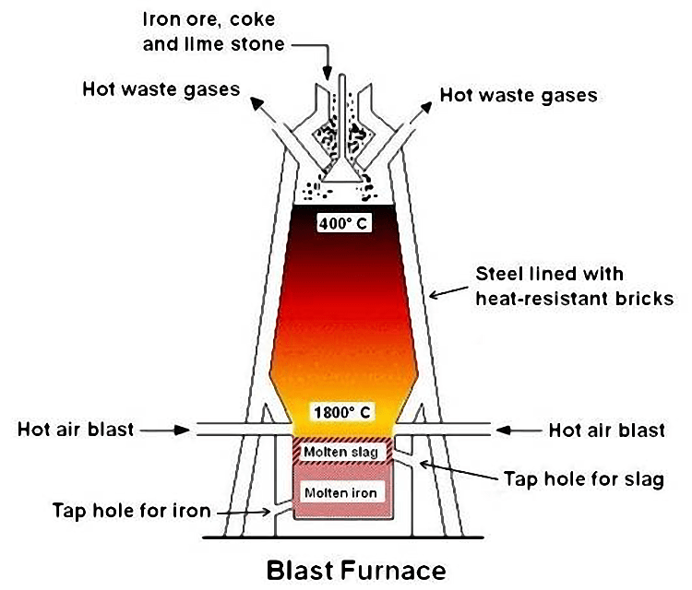
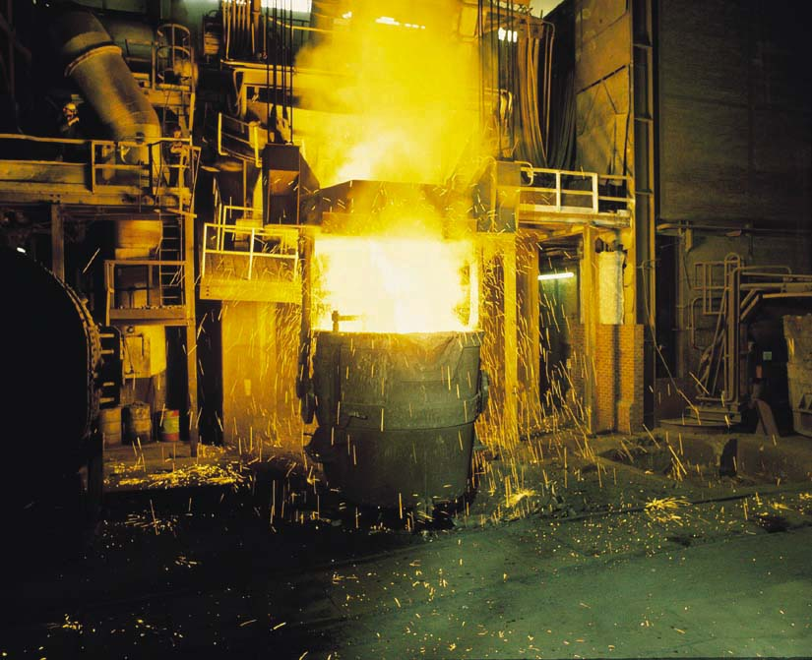
Modern Blast Furnace

Slide 19
Global Exploration – chasing resources
As Europe grew, needed to develop new sources of resources
→ Global Exploration
Portugal and Spain started fighting over resources in the “New Worlds”
1494 - Pope intervened and divided the world into two halves.
Spain got the world west of the Cape Verde Islands
→ Queue exploitation of the Americas by the Spanish.
Notes:
Cape verde islands are in the North Atlantic

Slide 20


Aztec Gold

Slide 21
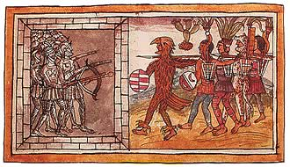
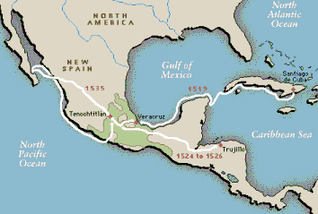
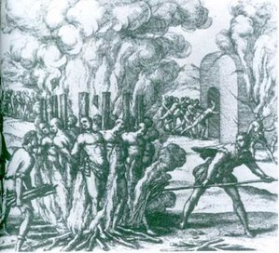
Genocide of the Aztecs

Slide 22
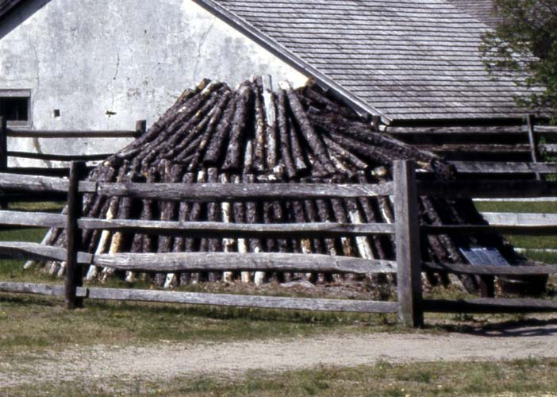
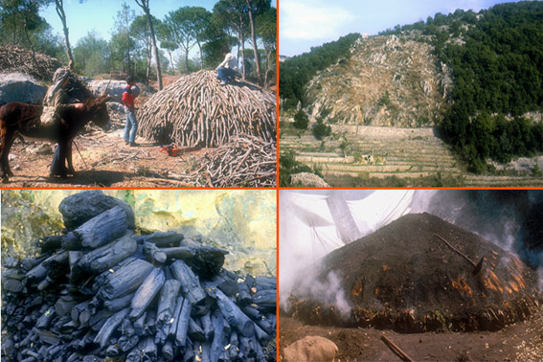
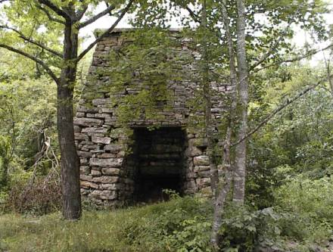
Meanwhile, the Iron Age starts an Environmental Crisis
The demand for iron lead to an energy crisis and forests were cut down to produce charcoal.
Notes:
This is still occurring today in Central and South America

Slide 23
The need for a new energy supply grew
By the 18th century, England's forests were very depleted, and it threatened England's economy.
The price index of wood charcoal quadrupled from 1560 to 1660 while the price of everything else doubled in the same time span.
This meant England needed a new source of energy, largely, to fuel the Iron Industry.

Slide 24
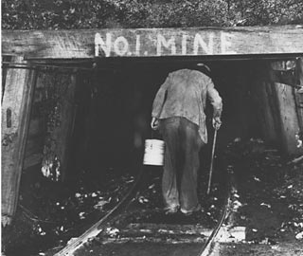
Economics of Energy and Iron
Fuel is the largest input for making iron, thus iron furnaces were located closer to the fuel source than the iron ore.
Charcoal furnaces had to be kept smaller and more spread out (near the forests)
i.e. lower returns and higher costs.
fuel source determined the economies of scale of iron making.
SOLUTION: COAL
Coal developed as the new source of fuel for iron
Allowed more and larger iron production furnaces
close to a single coal seam

Slide 25
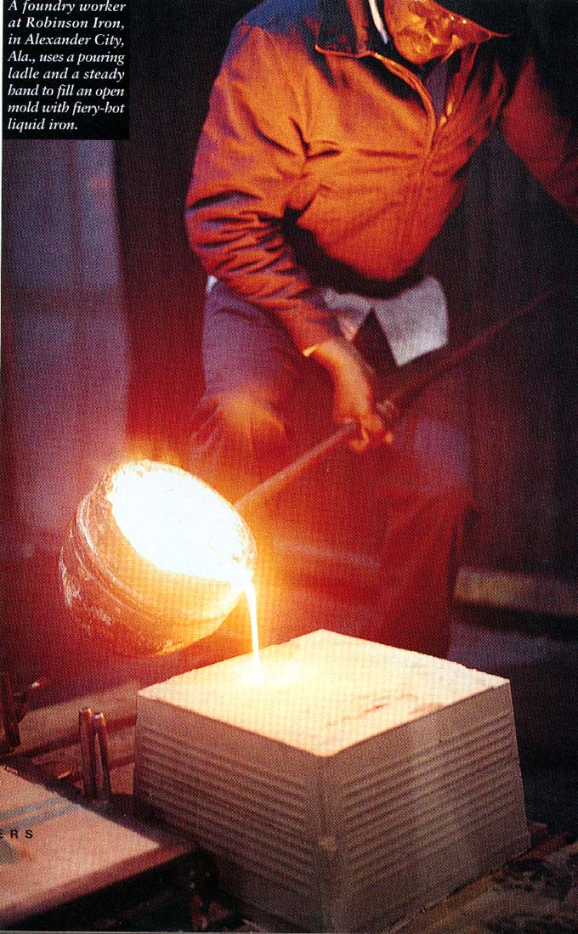
Cast iron was not sufficient to meet the needs of technology
Coke Smelters and Carbon Steel
Cast iron was brittle and hard to work.
Coke made by heating coal in absence of air – drives off volatiles – higher carbon content and thus burns hotter than coal
Around 1740, carbon steel was created
blow air through molten iron
lowers the carbon content to less than 1%
The result was a harder and more workable product.
Notes:
Coke is a fuel with a high carbon content and few impurities, made by heating coal in the absence of air.

Slide 26
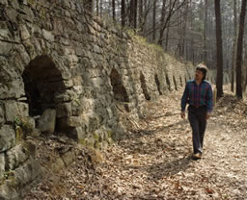
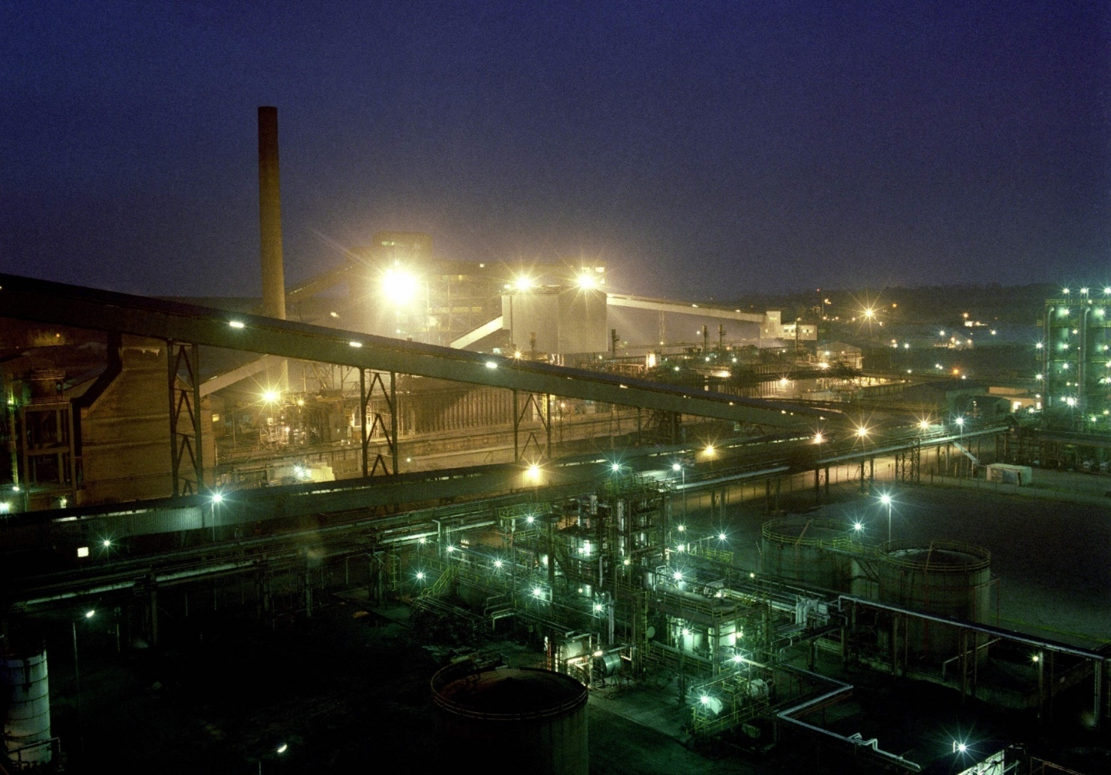
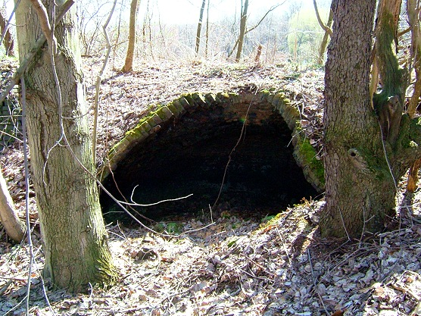
Early Coke Ovens
Modern Coke Ovens

Slide 27
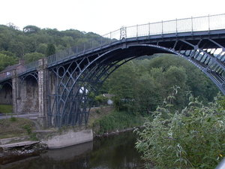
Carbon Steel Revolution
Carbon steel is not only stronger and easier to work, its more flexible.
This flexibility was critical, it allowed us to use steel in construction, like bridges, where flexing is very important
Darby Bridge
Built ~1750

Slide 28
The transition to the Industrial Age
The Iron Age led to the Industrial Revolution (IR) which was fueled by population growth
Urban and industrial society
Others make your goods (in factories)
Rural, agrarian society
You make your own goods

Slide 29
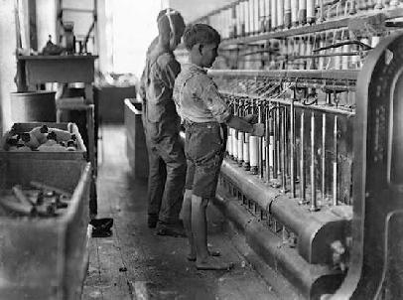
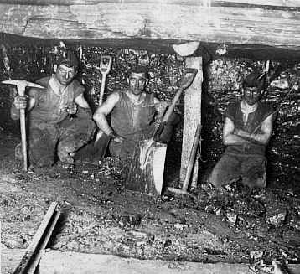
Impact of IR on Working conditions
Child labor
Dangerous
Working
Conditions

Slide 30

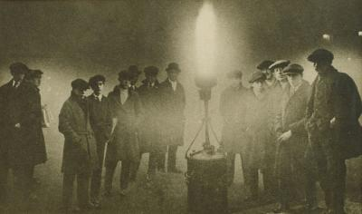
And Pollution…

Slide 31
Implications of IR on Society
The overall effects were:
(1) people migrated to cities
(2) environmental degradation accelerated.
In addition, the need for more energy (coal) created a need for better transportation systems – railroads and canals were built.

Slide 32
IR and other metals
The Industrial Revolution led to many other metals being discovered and utilized, in particular Nickel
Ni-Steel developed in 1889, most Ni-steel is used in military applications for rocket shells, tank armor, and so on.

Slide 33
Steel Alloys were developed
The largest use is in making stainless steel (along with chromium). As much as 70% of nickel goes to make stainless or other steel alloys. With concentrations of up to 45%, nickel adds strength and corrosion resistance.
Nickel-copper is also the alloy of which coins are made. The U.S. nickel is 25% nickel and 75% copper.
Aluminum was discovered in 1827, but was hard to extract.
Eventually, many other metals were combined with steel, such as cobalt, titanium, and molybdenum.

Slide 34
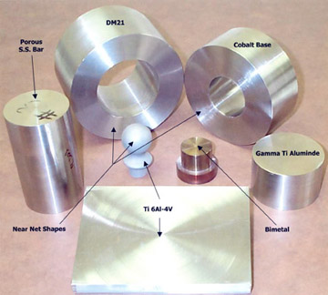
Specialty Alloys

Slide 35
This changed Technology
These advances were spurred by development of the internal combustion engine, aircraft, and weaponry.
Aircraft manufacturing spurred the use of aluminum and titanium.
Jet engines need high strength, yet light, components that can stand high temperatures.

Slide 36
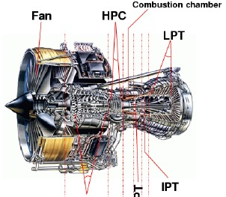
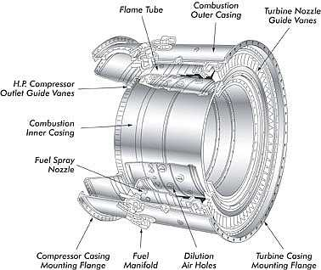
Iron Alloys in Jet Engines

Slide 37
Environmental Impacts of Technological Advances
Stone Age > Copper Age > Bronze Age > Iron Age
To go from one age to the next required greater energy resources, and increasingly complicated ones.
Wood > charcoal > coal > oil
Each step required an increase in complexity

